Slide 1
Relational Database Management System 116U01C403
Module 2 .1 & 2.2 Jan 2024-May 2024

Slide 2
Data Modeling: Enhanced-Entity-Relationship Model and Relational Data Model
Introduction, Benefits of Data Modeling, Types of Models, Phases of Database Modeling, The Entity-Relationship (ER) Model
Enhanced -Entity-Relationship (EER)- Model Generalization, Specialization and Aggregation
Relational Model: Introduction, Data Manipulation, Data Integrity, Advantages of the Relational Model
Mapping EER Model to Relational Model

Slide 3
Overview of Database Design Process
Two main activities:
Database design:
To design the conceptual schema for a database application
Applications design:
To focus on the programs and interfaces that access the database

Slide 4
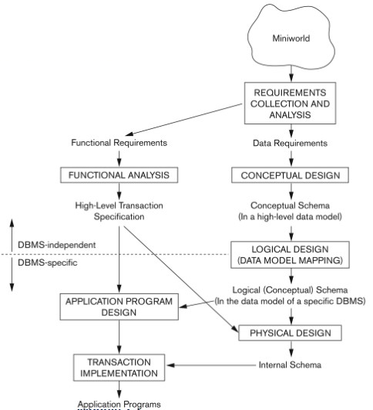
Database design process

Slide 5
ER Model (Entity Relational Model)
The Entity Relational Model is a model for identifying entities to be represented in the database and representation of how those entities are related.
The ER data model specifies enterprise schema that represents the overall logical structure of a database graphically.
Why Use ER Diagrams In DBMS?
ER diagrams are used to represent the E-R model in a database, which makes them easy to be converted into relations (tables).
ER diagrams provide the purpose of real-world modeling of objects which makes them intently useful.
ER diagrams require no technical knowledge and no hardware support.
These diagrams are very easy to understand and easy to create even for a naive user.
It gives a standard solution for visualizing the data logically.

Slide 6
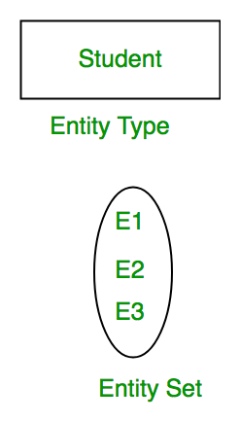
Entity
An Entity may be an object with a physical existence – a particular person, car, house, or employee – or it may be an object with a conceptual existence – a company, a job, or a university course.
Entity Set: An Entity is an object of Entity Type and a set of all entities is called an entity set. For Example, E1 is an entity having Entity Type Student and the set of all students is called Entity Set.

Slide 7
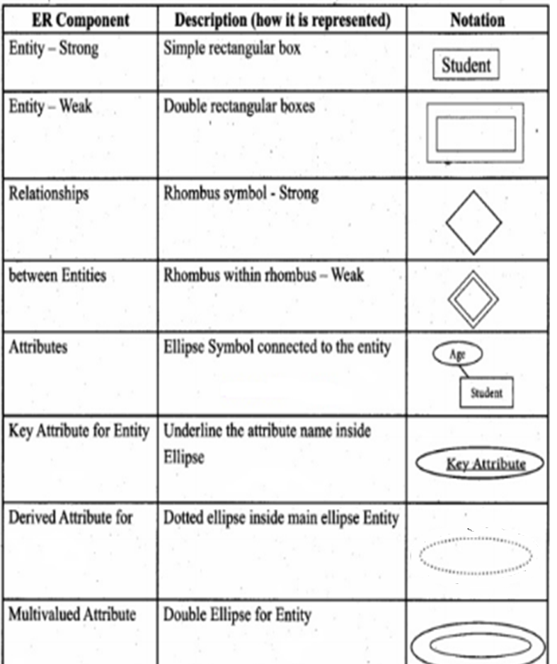
Symbols Used in ER Model

Slide 8
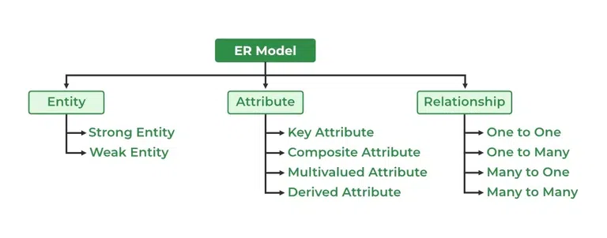
Components of ER Model

Slide 9
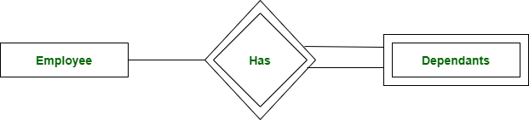
1. Strong Entity
A Strong Entity is a type of entity that has a key Attribute. Strong Entity does not depend on other Entity in the Schema. It has a primary key, that helps in identifying it uniquely, and it is represented by a rectangle. These are called Strong Entity Types.
2. Weak Entity
An Entity type has a key attribute that uniquely identifies each entity in the entity set. But some entity type exists for which key attributes can’t be defined. These are called Weak Entity types.
For Example, A company may store the information of dependents (Parents, Children, Spouse) of an Employee. But the dependents don’t have existed without the employee. So Dependent will be a Weak Entity Type and Employee will be Identifying Entity type for Dependent, which means it is Strong Entity Type.

Slide 10
Attributes
Attributes are the properties that define the entity type. For example, Roll_No, Name, DOB, Age, Address, and Mobile_No are the attributes that define entity type Student.
Key Attribute
The attribute which uniquely identifies each entity in the entity set is called the key attribute. For example, Roll_No will be unique for each student.
Composite Attribute
An attribute composed of many other attributes is called a composite attribute. For example, the Address attribute of the student Entity type consists of Street, City, State, and Country. In ER diagram, the composite attribute is represented by an oval comprising of ovals.
Multivalued Attribute
An attribute consisting of more than one value for a given entity. For example, Phone_No (can be more than one for a given student).
Derived Attribute
An attribute that can be derived from other attributes of the entity type is known as a derived attribute. e.g.; Age (can be derived from DOB).

Slide 11
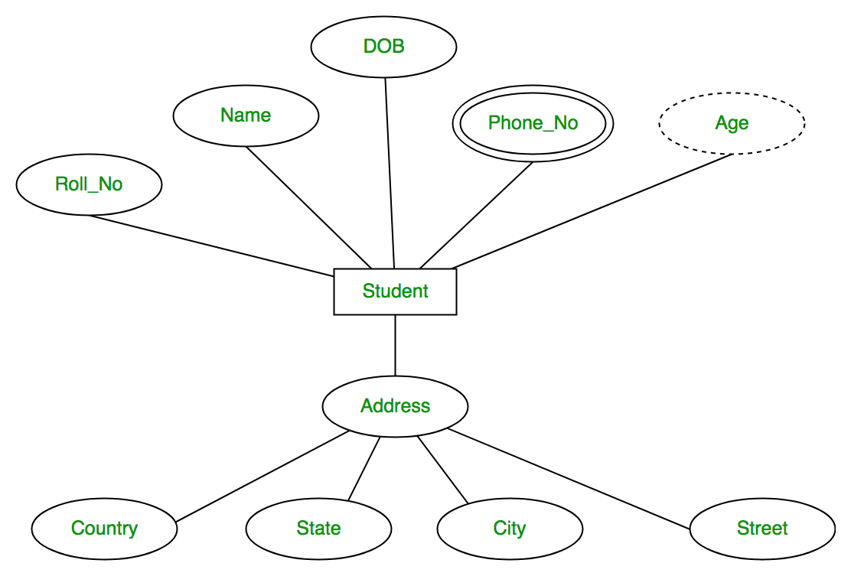

Slide 12
Example COMPANY Database
We need to create a database schema design based on the following (simplified) requirements of the COMPANY Database:
The company is organized into DEPARTMENTs. Each department has a name, number and an employee who manages the department.
We keep track of the start date of the department manager. A department may have several locations.
Each department controls a number of PROJECTs. Each project has a unique name, unique number and is located at a single location.

Slide 13
We store each EMPLOYEE’s social security number, address,salary, gender, and birthdate.
Each employee works for one department but may work on several projects.
We keep track of the number of hours per week that an employee currently works on each project.
We also keep track of the direct supervisor of each employee.
Each employee may have a number of DEPENDENTs.
For each dependent, we keep track of their name, gender, birthdate, and relationship to the employee.

Slide 14
ER Model Concepts
Entities and Attributes
Entities(noun) are specific objects or things in the mini-world that are represented in the database.
For example the EMPLOYEE John Smith, the Research DEPARTMENT, the ProductX PROJECT
Attributes are properties used to describe an entity.
For example an EMPLOYEE entity may have the attributes Name, SSN,Address, gender, BirthDate
A specific entity will have a value for each of its attributes.
For example a specific employee entity may have Name='John Smith’, SSN='123456789', Address ='731, Fondren, Houston, TX’, gender='M’, BirthDate='09-JAN-55‘
Each attribute has a value set (or data type) associated with it – e.g. integer, string, subrange, enumerated type, …

Slide 15
Initial Design of Entity Types for the COMPANY Database Schema
Based on the requirements, we can identify four initial entity types in the COMPANY database:
DEPARTMENT
PROJECT
EMPLOYEE
DEPENDENT
The initial attributes shown are derived from the requirements description

Slide 16
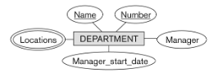

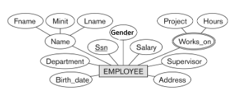

Initial Design of Entity Types:

Slide 17
Relationships and Relationship Types
A relationship relates two or more distinct entities with a specific meaning.
For example, EMPLOYEE John Smith works on the ProductX PROJECT, or EMPLOYEE Franklin Wong manages the Research DEPARTMENT.
Relationships of the same type are grouped or typed into a relationship type.
For example, the WORKS_ON relationship type in which EMPLOYEEs and PROJECTs participate, or the MANAGES relationship type in which EMPLOYEEs and DEPARTMENTs participate.
The degree of a relationship type is the number of participating entity types.
Both MANAGES and WORKS_ON are binary relationships.

Slide 18
Relationship Types
There are different types of Relationships like:
Binary Relationship
Ternary Relationship
N-Ary Relationship
Recursive Relationship

Slide 19
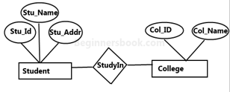
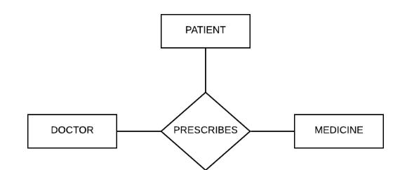
Binary Relationship:
When there is a relationship between
two different entities, it is known as
a binary relationship.
Ternary Relationship:
When there is a relationship between
three different entities, it is known as
a ternary relationship.

Slide 20

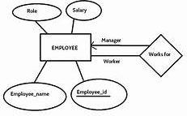
N-Ary Relationship: When any relationship consists of more than two Entities then it is called N-ary relationship.
Recursive Relationship
A relationship between two entities of
similar entity type is called a recursive
relationship.
Here the same entity type participates
more than once in a relationship type
with a different role for each instance.
We indicate roles in E-R diagrams by labeling the
lines that connect diamonds to rectangles.

Slide 21
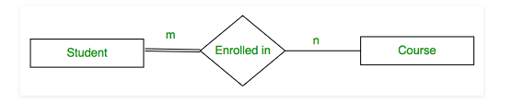
Participation Constraint
Participation Constraint is applied on the entity participating in the relationship set.
Total Participation:
Each entity in the entity set must participate in the relationship.
If each student must enroll in a course, the participation of student will be total.
Total participation is shown by double line in ER diagram.

Slide 22
Partial Participation
The entity in the entity set may or may NOT participate in the relationship.
If some courses are not enrolled by any of the student, the participation of course will be partial.
The diagram depicts the ‘Enrolled in’ relationship set with Student Entity set having total participation and Course Entity set having partial participation.

Slide 23
Mapping Cardinality/Mapping Constraints
Mapping cardinalities, or cardinality ratios, express the number of entities to which another entity can be associated via a relationship set.
For a binary relationship set R between entity sets A and B, the mapping cardinality must be one of the following:
One-To-One
One-To-Many
Many-To-One
Many-To-Many

Slide 24
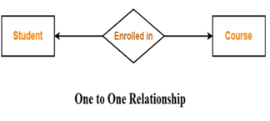
One-To-One
An entity in A is associated with at most one entity in B, and an entity in B is associated with at most one entity in A.
E.g. Student can enroll at most one course and course can have at most one student.
E.g. We draw a directed line from the relationship set advisor to both entity sets instructor and student. This indicates that an instructor may advise at most one student, and a student may have at most one advisor.

Slide 25
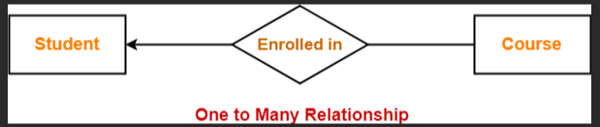
Mapping Cardinality
One-To-Many:An entity in A is associated with any number (zero or more)of entities in B. An entity in B, however, can be associated with at most one entity in A.
E.g. An instructor may advise many students, but a student may have at most one advisor.
e.g. A student can enrol for many courses

Slide 26
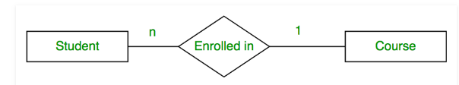
Many-To-One
An entity in A is associated with at most one entity in B. An entity in B, however, can be associated with any number (zero or more) of entities in A.
This is another notation which shows student can take at most one course and one course can be taken by many students.

Slide 27
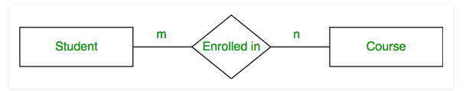
Many-To-Many
An entity in A is associated with any number (zero or more)of entities in B, and an entity in B is associated with any number (zero or more) of entities in A.
An instructor may advise many students, and a student may have many advisors.
This is another notation to show mapping cardinality. Which shows one student can take many courses and one course can be taken by many students.

Slide 28
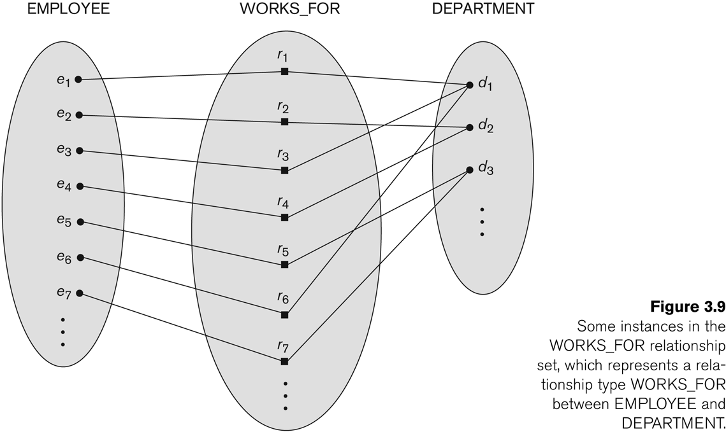
Relationship instances of the WORKS_FOR N:1 relationship between EMPLOYEE and DEPARTMENT

Slide 29
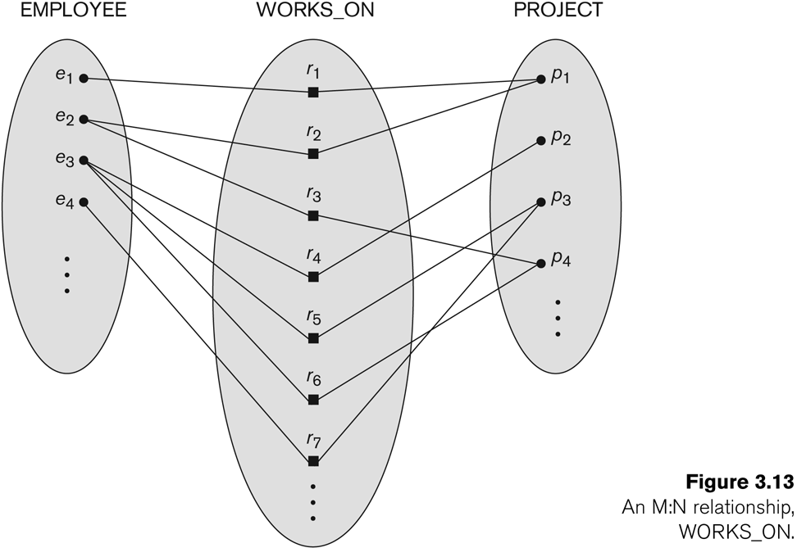
Relationship instances of the M:N WORKS_ON relationship between EMPLOYEE and PROJECT

Slide 30
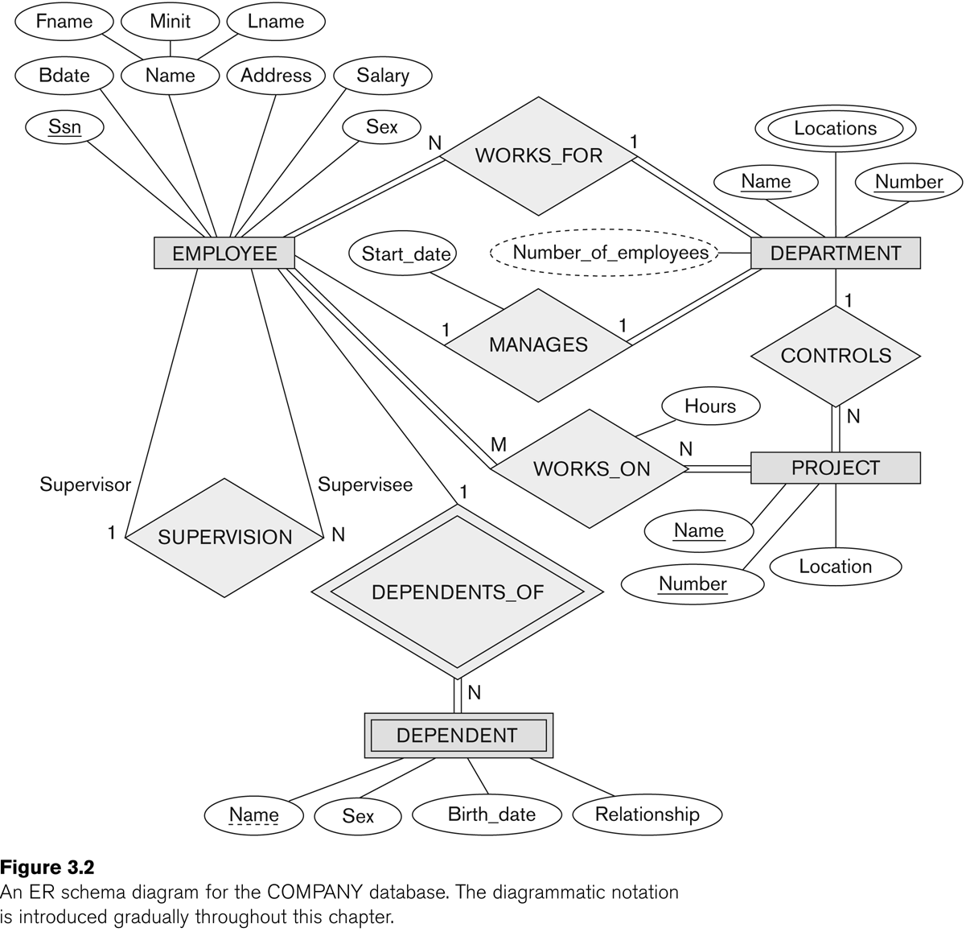

Slide 31
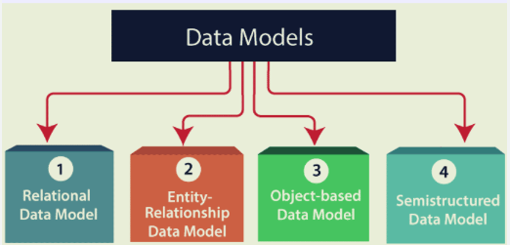
Types of Relational Models
Hierarchical Model
Network Model
Flat Data Model
Associative Data Model
Context Data Model

Slide 32
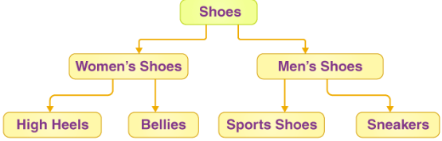
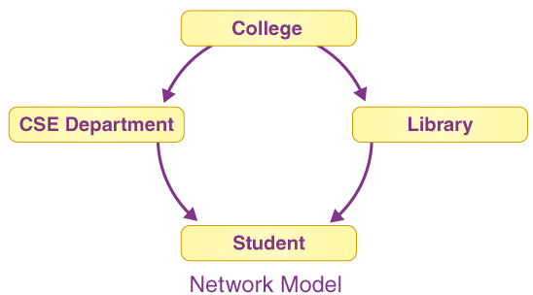
Hierarchical Model
In this, the data is organized into a tree-like structure where each record consists of one parent record and many children.
Network Model
Any record can have several parents in the network model. It uses a graph instead of a hierarchical tree.

Slide 33
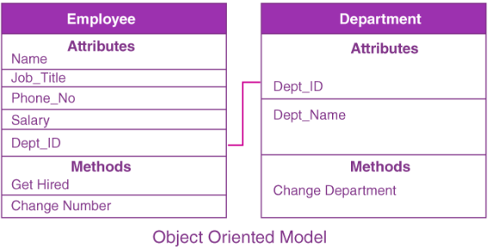
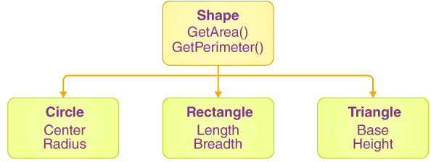
Object-Oriented Data Model
Both data and the data relationships are stored into a single structure that’s known as an object in the object-oriented data model.
Object-Relational Data Model
This model was developed to bridge the gap between the Object-Oriented and relational models.
Many additional capabilities are available, such as the ability to create complicated data types based on our requirements utilizing existing data types.
The issue with this paradigm is that it can become overly complicated and difficult to manage.

Slide 34
Flat Data Model
It’s a straightforward model in which the DB is depicted as a table with rows and columns.
A flat data model is one in which all of the data is kept in the same plane.
This data model has one drawback it cannot store a large amount of data that is the tables can not be of large size.
Semi-Structured Data Model
Semi-structured data refers to the structured data that doesn’t adhere to the tabular structure of the data models that are associated with relational DBs.

Slide 35
Associative Data Model
It is a model in which the data is separated into two sections.
Everything that has its own existence is referred to as an entity, and the relationships between these entities are referred to as associations.
Items and links are two types of data that are separated into two components.
Context data model
It is simply a data model which consists of more than one data model.
For example, the Context data model consists of ER Model, Object-Oriented Data Model, etc. This model allows users to do more than one thing which each individual data model can do.

Slide 36
Enhanced Entity Relationship model
It is a diagrammatic technique for displaying the following concepts:
Sub Class and Super Class
Specialization and Generalization
Union or Category
Aggregation

Slide 37
Subclasses and Superclasses
An entity type may have additional meaningful subgroupings of its entities
Example: EMPLOYEE may be further grouped into:
SECRETARY, ENGINEER, TECHNICIAN, …
Based on the EMPLOYEE’s Job
MANAGER
EMPLOYEEs who are managers
SALARIED_EMPLOYEE, HOURLY_EMPLOYEE
Based on the EMPLOYEE’s method of pay
EER diagrams extend ER diagrams to represent these additional subgroupings, called subclasses or subtypes

Slide 38
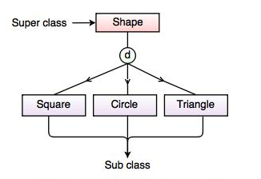
Sub class and Super class relationship leads the concept of Inheritance.
1. Super Class: Super class is an entity type that has a relationship with one or more subtypes.
For example: Shape super class is having sub groups as Square, Circle, Triangle.
2. Sub Class: It is a group of entities with unique attributes.
Sub class inherits properties and attributes from its super class. For example: Square, Circle, Triangle are the sub class of Shape super class.

Slide 39
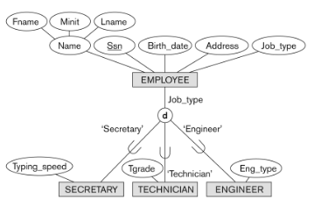
Representing Specialization in EER Diagrams

Slide 40
Attribute Inheritance in Superclass / Subclass Relationships
An entity that is member of a subclass inherits
All attributes of the entity as a member of the superclass
All relationships of the entity as a member of the superclass
Example:
In the previous slide, SECRETARY (as well as TECHNICIAN and ENGINEER) inherit the attributes Name, SSN, …, from EMPLOYEE
Every SECRETARY entity will have values for the inherited attributes
Slide 4- ‹#›
Notes:
‹#›

Slide 41
Specialization (1)
Specialization is the process of defining a set of subclasses of a superclass
The set of subclasses is based upon some distinguishing characteristics of the entities in the superclass
Example: {SECRETARY, ENGINEER, TECHNICIAN} is a specialization of EMPLOYEE based upon job type.
May have several specializations of the same superclass
Slide 4- ‹#›
Notes:
‹#›

Slide 42
Specialization (2)
Example: Another specialization of EMPLOYEE based on method of pay is {SALARIED_EMPLOYEE, HOURLY_EMPLOYEE}.
Superclass/subclass relationships and specialization can be diagrammatically represented in EER diagrams
Attributes of a subclass are called specific or local attributes.
For example, the attribute TypingSpeed of SECRETARY
The subclass can also participate in specific relationship types.
For example, a relationship BELONGS_TO of HOURLY_EMPLOYEE
Slide 4- ‹#›
Notes:
‹#›

Slide 43
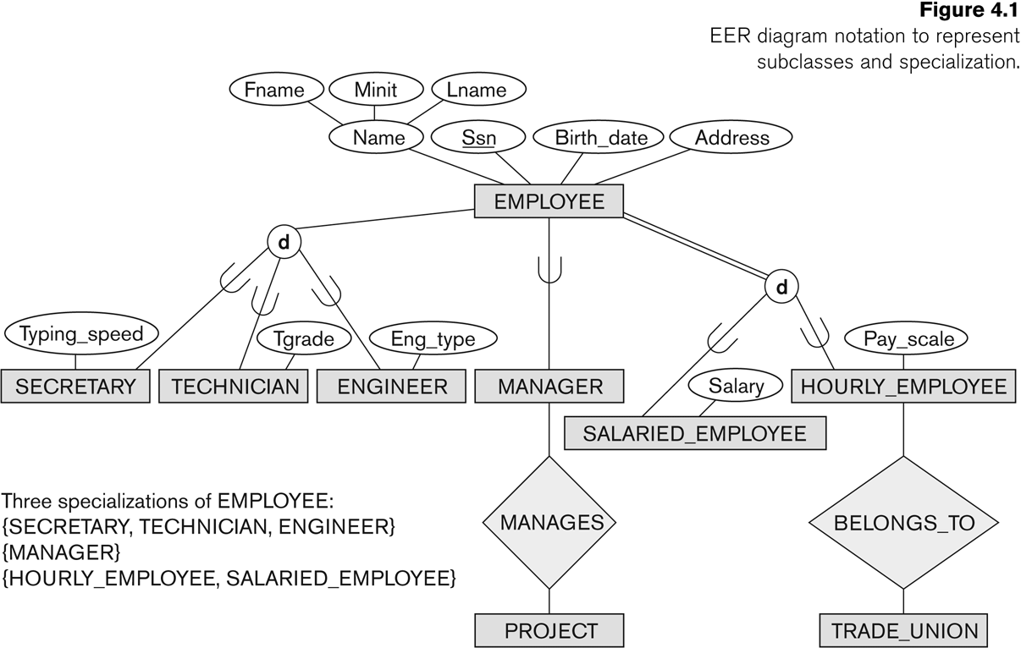
Specialization (3)
Slide 4- ‹#›
Notes:
‹#›

Slide 44
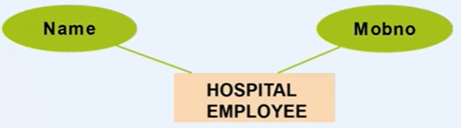
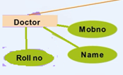
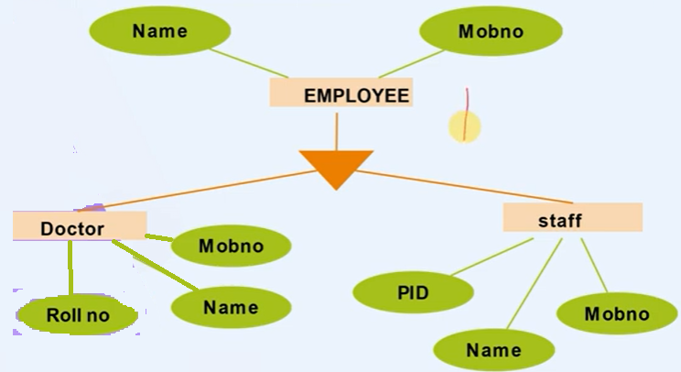
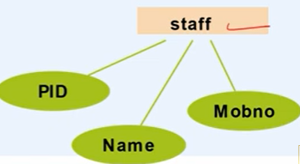
Example of Specialization

Slide 45
Generalization
Generalization is the reverse of the specialization process
Several classes with common features are generalized into a superclass;
original classes become its subclasses
Example: CAR, TRUCK generalized into VEHICLE;
both CAR, TRUCK become subclasses of the superclass VEHICLE.
We can view {CAR, TRUCK} as a specialization of VEHICLE
Alternatively, we can view VEHICLE as a generalization of CAR and TRUCK
Slide 4- ‹#›
Notes:
‹#›

Slide 46
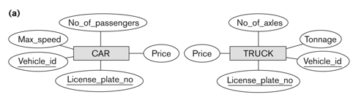
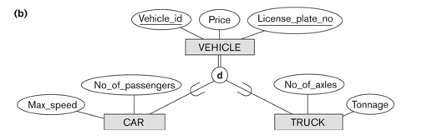

Generalization (2)
Slide 4- ‹#›
Notes:
‹#›

Slide 47
Generalization and Specialization (1)
Diagrammatic notation are sometimes used to distinguish between generalization and specialization
Arrow pointing to the generalized superclass represents a generalization
Arrows pointing to the specialized subclasses represent a specialization
We do not use this notation because it is often subjective as to which process is more appropriate for a particular situation
We advocate not drawing any arrows
Slide 4- ‹#›
Notes:
‹#›

Slide 48
Generalization and Specialization (2)
Data Modeling with Specialization and Generalization
A superclass or subclass represents a collection (or set or grouping) of entities
It also represents a particular type of entity
Shown in rectangles in EER diagrams (as are entity types)
We can call all entity types (and their corresponding collections) classes, whether they are entity types, superclasses, or subclasses
Slide 4- ‹#›
Notes:
‹#›

Slide 49
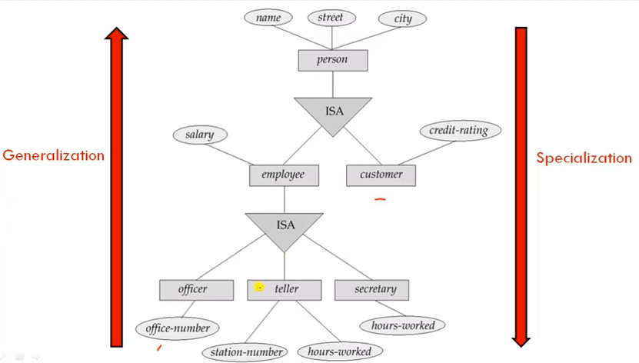

Slide 50
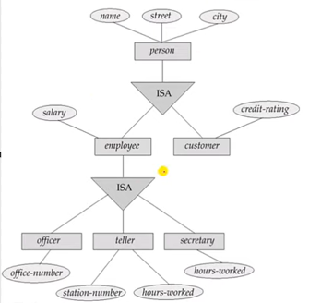
Four tables can be formed:
Customer(name,street,city,credit_rating)
Officer(name,street,city,salary,office_number)
Teller(name,street,city,salary,station_number,hours_worked)
Secretary(name,strret,city,hours_worked)

Slide 51
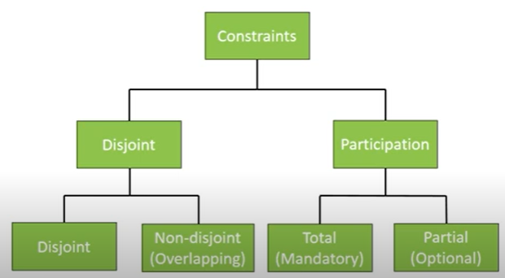
Constraints on Specialization and Generalization
Two basic constraints can apply to a specialization/generalization:
Disjoint Constraint:
Completeness/Participation Constraint:
Slide 4- ‹#›
Notes:
‹#›

Slide 52
Constraints on Specialization and Generalization (4)
Disjointness Constraint:
Specifies that the subclasses of the specialization must be disjoint:
an entity can be a member of at most one of the subclasses of the specialization
Specified by d in EER diagram
If not disjoint, specialization is overlapping:
that is the same entity may be a member of more than one subclass of the specialization
Specified by o in EER diagram
Slide 4- ‹#›
Notes:
‹#›

Slide 53
Constraints on Specialization and Generalization (5)
Completeness Constraint:
Total specifies that every entity in the superclass must be a member of some subclass in the specialization/generalization
Shown in EER diagrams by a double line
Partial allows an entity not to belong to any of the subclasses
Shown in EER diagrams by a single line
Slide 4- ‹#›
Notes:
‹#›

Slide 54
Constraints on Specialization and Generalization (6)
Hence, we have four types of specialization/generalization:
Disjoint, total
Disjoint, partial
Overlapping, total
Overlapping, partial
Note: Generalization usually is total because the superclass is derived from the subclasses.
Slide 4- ‹#›
Notes:
‹#›

Slide 55

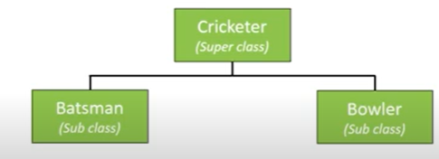
Disjoint Constraint
It specifies that the subclasses of the specialization must be disjoint.
This means that an entity can be a member of at most one of the
subclasses of the specialization. It is denoted by ‘d’in circle.
In the diagram Employee can be either Secretary or Technician or Engineer

Slide 56
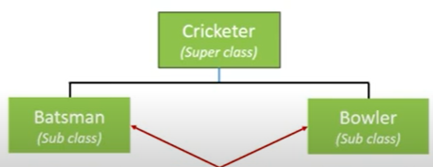

Overlapping Constraint
If the subclasses are not constrained to be disjoint, their sets of entities may be overlapping; that is, the same entity may be a member of more than one subclass of the specialization.
This case, which is the default, is displayed by placing an ‘o’ in the circle.

Slide 57
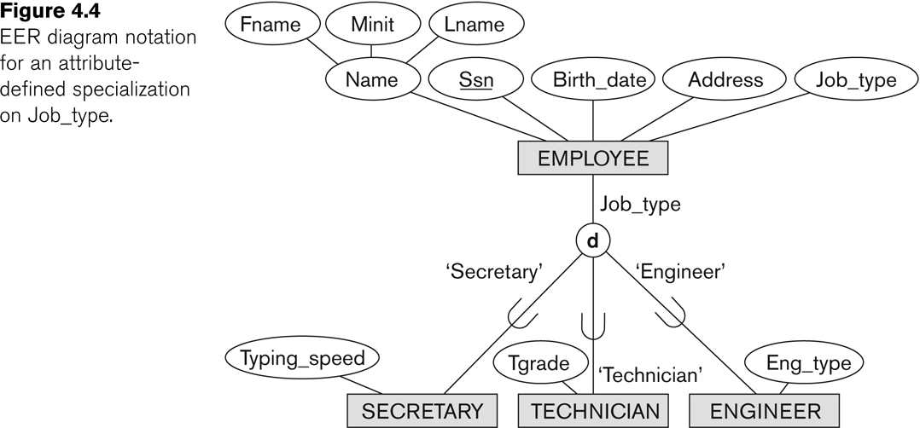
Example of disjoint partial Specialization
Slide 4- ‹#›
Notes:
‹#›

Slide 58
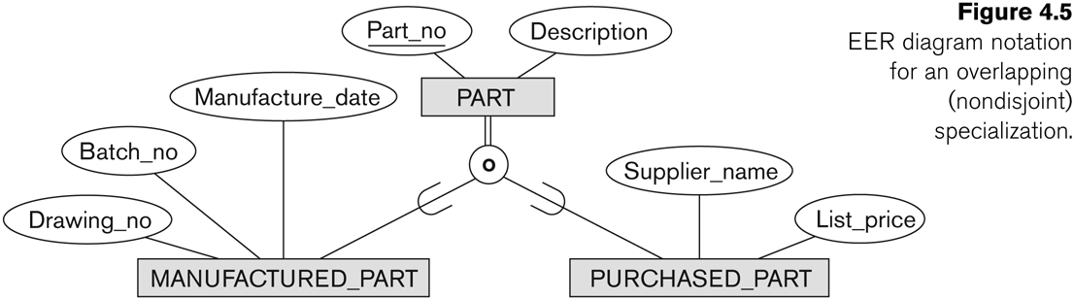
Example of overlapping total Specialization
Slide 4- ‹#›
Notes:
‹#›

Slide 59
Specialization/Generalization Hierarchies, Lattices & Shared Subclasses (1)
A subclass may itself have further subclasses specified on it
forms a hierarchy or a lattice
Hierarchy has a constraint that every subclass has only one superclass (called single inheritance); this is basically a tree structure
In a lattice, a subclass can be subclass of more than one superclass (called multiple inheritance)
Slide 4- ‹#›
Notes:
‹#›

Slide 60
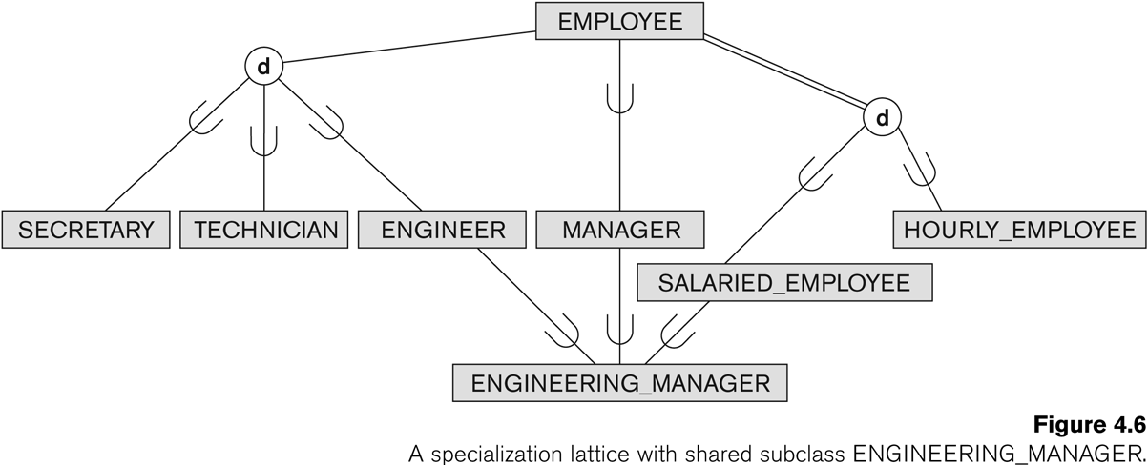
Shared Subclass “Engineering_Manager”
Slide 4- ‹#›
Notes:
‹#›

Slide 61
Specialization/Generalization Hierarchies, Lattices & Shared Subclasses (2)
In a lattice or hierarchy, a subclass inherits attributes not only of its direct superclass, but also of all its predecessor superclasses
A subclass with more than one superclass is called a shared subclass (multiple inheritance)
Can have:
specialization hierarchies or lattices, or
generalization hierarchies or lattices,
depending on how they were derived
We just use specialization (to stand for the end result of either specialization or generalization)
Slide 4- ‹#›
Notes:
‹#›

Slide 62
Specialization/Generalization Hierarchies, Lattices & Shared Subclasses (3)
In specialization, start with an entity type and then define subclasses of the entity type by successive specialization
called a top down conceptual refinement process
In generalization, start with many entity types and generalize those that have common properties
Called a bottom up conceptual synthesis process
In practice, a combination of both processes is usually employed
Slide 4- ‹#›
Notes:
‹#›

Slide 63
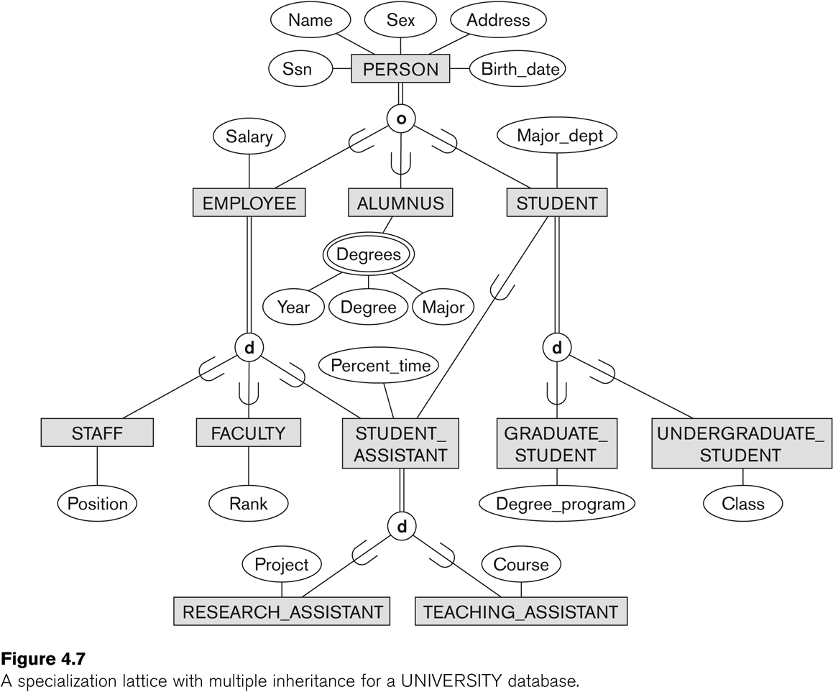
Specialization / Generalization Lattice Example (UNIVERSITY)
Slide 4- ‹#›
Notes:
‹#›

Slide 64
Categories (UNION TYPES) (1)
All of the superclass/subclass relationships we have seen thus far have a single superclass
A shared subclass is a subclass in:
more than one distinct superclass/subclass relationships
each relationships has a single superclass
shared subclass leads to multiple inheritance
In some cases, we need to model a single superclass/subclass relationship with more than one superclass
Superclasses can represent different entity types
Such a subclass is called a category or UNION TYPE
Slide 4- ‹#›
Notes:
‹#›

Slide 65
Categories (UNION TYPES) (2)
Example: In a database for vehicle registration, a vehicle owner can be a PERSON, a BANK (holding a lien on a vehicle) or a COMPANY.
A category (UNION type) called OWNER is created to represent a subset of the union of the three superclasses COMPANY, BANK, and PERSON
A category member must exist in at least one of its superclasses
Difference from shared subclass, which is a:
subset of the intersection of its superclasses
shared subclass member must exist in all of its superclasses
Slide 4- ‹#›
Notes:
‹#›

Slide 66
Formal Definitions of EER Model (1)
Class C:
A type of entity with a corresponding set of entities:
could be entity type, subclass, superclass, or category
Note: The definition of relationship type in ER/EER should have 'entity type' replaced with 'class‘ to allow relationships among classes in general
Subclass S is a class whose:
Type inherits all the attributes and relationship of a class C
Set of entities must always be a subset of the set of entities of the other class C
S ⊆ C
C is called the superclass of S
A superclass/subclass relationship exists between S and C
Slide 4- ‹#›
Notes:
‹#›

Slide 67
Formal Definitions of EER Model (2)
Specialization Z: Z = {S1, S2,…, Sn} is a set of subclasses with same superclass G; hence, G/Si is a superclass relationship for i = 1, …., n.
G is called a generalization of the subclasses {S1, S2,…, Sn}
Z is total if we always have:
S1 ∪ S2 ∪ … ∪ Sn = G;
Otherwise, Z is partial.
Z is disjoint if we always have:
Si ∩ Sj empty-set for i ≠ j;
Otherwise, Z is overlapping.
Slide 4- ‹#›
Notes:
‹#›

Slide 68
Formal Definitions of EER Model (3)
Subclass S of C is predicate defined if predicate (condition) p on attributes of C is used to specify membership in S;
that is, S = C[p], where C[p] is the set of entities in C that satisfy condition p
A subclass not defined by a predicate is called user-defined
Attribute-defined specialization: if a predicate A = ci (where A is an attribute of G and ci is a constant value from the domain of A) is used to specify membership in each subclass Si in Z
Note: If ci ≠ cj for i ≠ j, and A is single-valued, then the attribute-defined specialization will be disjoint.
Slide 4- ‹#›
Notes:
‹#›

Slide 69
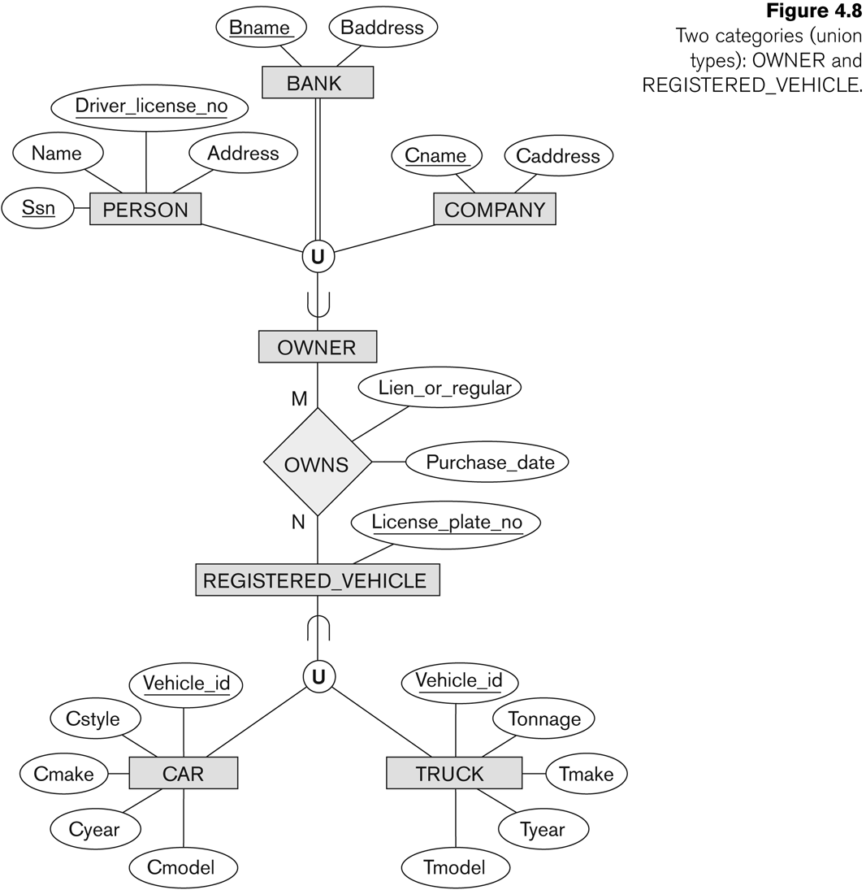
Two categories (UNION types): OWNER, REGISTERED_VEHICLE
Slide 4- ‹#›
Notes:
‹#›

Slide 70
Formal Definitions of EER Model (4)
Category or UNION type T
A class that is a subset of the union of n defining superclasses D1, D2,…Dn, n>1:
T ⊆ (D1 ∪ D2 ∪ … ∪ Dn)
Can have a predicate pi on the attributes of Di to specify entities of Di that are members of T.
If a predicate is specified on every Di: T = (D1[p1] ∪ D2[p2] ∪…∪ Dn[pn])
Slide 4- ‹#›
Notes:
‹#›

Slide 71
Alternative diagrammatic notations
ER/EER diagrams are a specific notation for displaying the concepts of the model diagrammatically
DB design tools use many alternative notations for the same or similar concepts
One popular alternative notation uses UML class diagrams
see next slides for UML class diagrams and other alternative notations
Slide 4- ‹#›

Slide 72
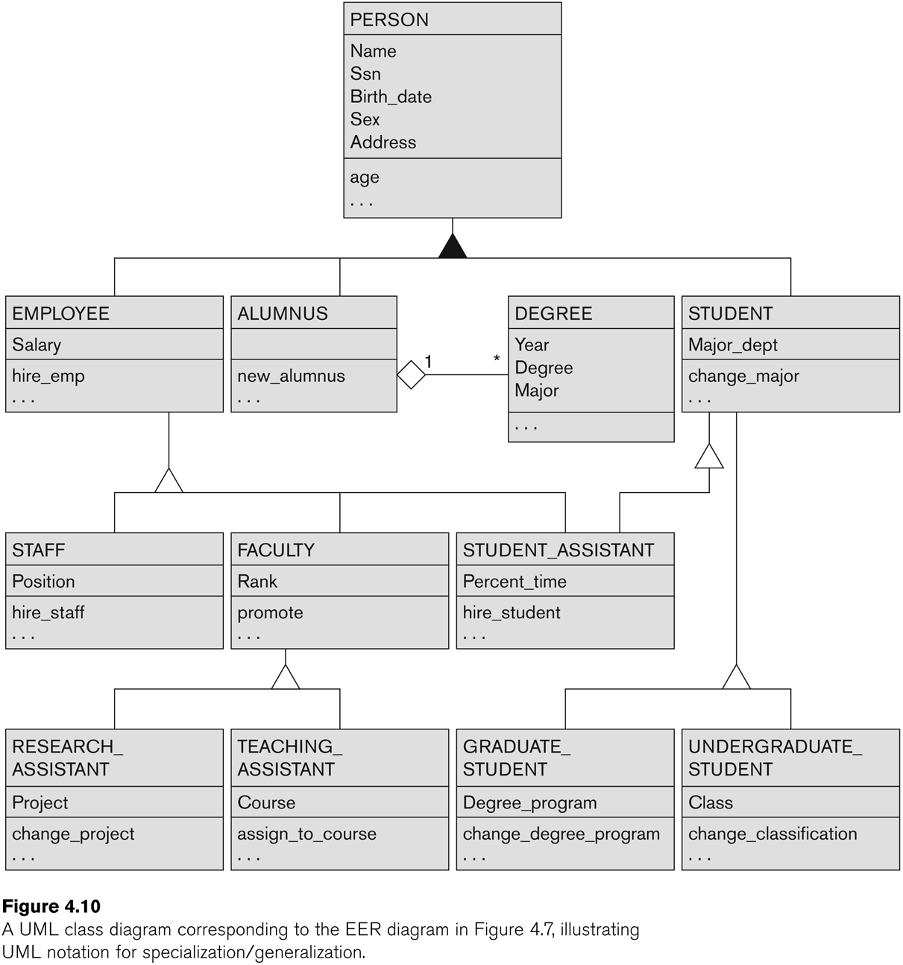
UML Example for Displaying Specialization / Generalization
Slide 4- ‹#›
Notes:
‹#›

Slide 73
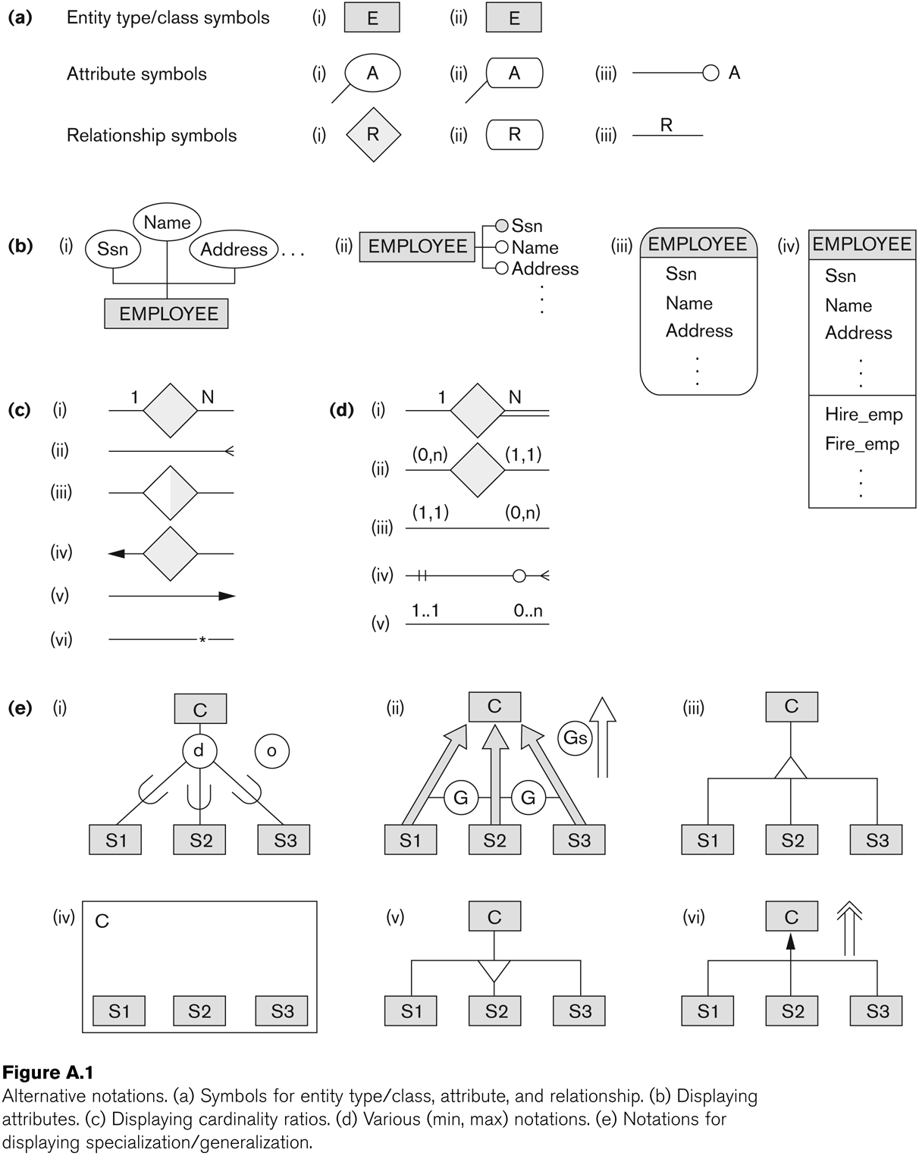
Alternative Diagrammatic Notations
Slide 4- ‹#›
Notes:
‹#›

Slide 74
General Conceptual Modeling Concepts
GENERAL DATA ABSTRACTIONS
CLASSIFICATION and INSTANTIATION
AGGREGATION and ASSOCIATION (relationships)
GENERALIZATION and SPECIALIZATION
IDENTIFICATION
CONSTRAINTS
CARDINALITY (Min and Max)
COVERAGE (Total vs. Partial, and Exclusive (disjoint) vs. Overlapping)
Slide 4- ‹#›
Notes:
‹#›

Slide 75
Ontologies
Use conceptual modeling and other tools to develop “a specification of a conceptualization”
Specification refers to the language and vocabulary (data model concepts) used
Conceptualization refers to the description (schema) of the concepts of a particular field of knowledge and the relationships among these concepts
Many medical, scientific, and engineering ontologies are being developed as a means of standardizing concepts and terminology
Slide 4- ‹#›

Slide 76
Summary
Introduced the EER model concepts
Class/subclass relationships
Specialization and generalization
Inheritance
These augment the basic ER model concepts introduced in Chapter 3
EER diagrams and alternative notations were presented
Slide 4- ‹#›

